Slide 1
Consequences of Credit Crisis Collateral Management
Group 4: Kun Deng
Ming Li
Siying Liu
Shi Qiu
Wangshu Peng

Slide 2
Content
Origins of Financial Crisis
Overview of Dodd Frank Act
The Impact on Collateral Management
Summary

Slide 3
A brief summary of the origins of Credit Crisis in 2008:“With half a decade's hindsight, it is clear the crisis had multiple causes.
Origins of Financial Crisis
Overview of Dodd Frank Act
The Impact on Collateral Management
Summary
Brief Summary
House price in 2006
From houses to money market
Lehman Brothers’ bankruptcy
Risky CDOs Investment Banks
Investors
Subprime borrows default CDOs become worthless
Bankruptcy of Investment Banks
Credit Crisis in 2008

Slide 4
Starting in 2006, America suffered a nationwide house-price slump
Origins of Financial Crisis
Overview of Dodd Frank Act
The Impact on Collateral Management
Summary
Brief Summary
House price in 2006
From houses to money market
Lehman Brothers’ bankruptcy
Loans were doled out to “subprime” borrowers with poor credit.
Bankers created “low-risk” securities (Collateralized debt obligations/CDOs) base on pooled mortgages.
Investors found these securitized products attractive.

Slide 5
From houses to money market in 2007
Origins of Financial Crisis
Overview of Dodd Frank Act
The Impact on Collateral Management
Summary
Brief Summary
House price in 2006
From houses to money market
Lehman Brothers’ bankruptcy
Because the house price started to fall, more and more borrowers defaulted to repay.
Mortgage-backed securities slumped in value, and CDOs turned out to be worthless.
In 2007, banks started questioning the viability of their counterparties, and trust system began to collapse.

Slide 6
Lehman Brothers filed for bankruptcy
Origins of Financial Crisis
Overview of Dodd Frank Act
The Impact on Collateral Management
Summary
Brief Summary
House price in 2006
From houses to money market
Lehman Brothers’ bankruptcy
Lehman Brothers was the fourth largest investment bank in the US in 2008.
Lehman had a high degree of leverage and a huge portfolio of mortgage securities.
On September 15, 2008, Lehman collapsed and “contributed to the erosion of close to $10 trillion in market capitalization from global equity market”.
On September 16, 2008, US federal government gave AIG a bailout of $85 billion

Slide 7
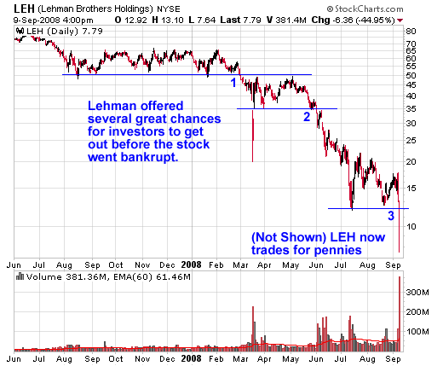
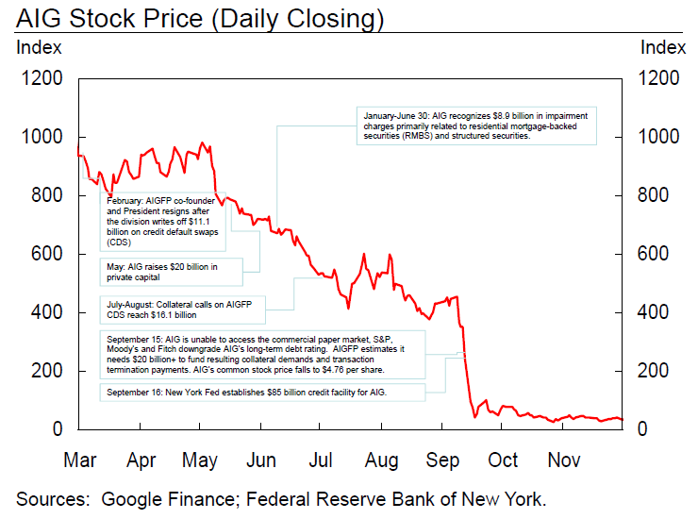
Origins of Financial Crisis
Overview of Dodd Frank Act
The Impact on Collateral Management
Summary
Brief Summary
House price in 2006
From houses to money market
Lehman Brothers’ bankruptcy
AIG’s Common stock price fell to $4.76 per share on September 15, 2008

Slide 8


Financial Regulatory Reform
The Dodd–Frank Wall Street Reform
and Consumer Protection Act（2010.07）

Slide 9
Origins of Financial Crisis
Overview of Dodd Frank Act
The Impact on Collateral Management
Summary
Brief Summary
Overview of Dodd-Frank Act
Aim of the legislation
1.Increase transparency
2.Reduce counterparty risk

Slide 10



Origins of Financial Crisis
Overview of Dodd Frank Act
The Impact on Collateral Management
Summary
Brief Summary
Key Implications

Slide 11
Origins of Financial Crisis
Overview of Dodd Frank Act
The Impact on Collateral Management
Summary
Brief Summary
Impact of the reform
1.More collateral will be needed
2.High grade collateral will be in short supply
3.T+0 margin movements will place further demands on collateral
4.Operational complexity will increase
5.Collateral optimization will become a strategic priority

Slide 12
Origins of Financial Crisis
Overview of Dodd Frank Act
The Impact on Collateral Management
Summary
Brief Summary
Other famous reforms
The Third Basel Accord ( Basel III )
The Solvency II Directive ( Solvency II )
European Market Infrastructure Regulation ( EMIR )

Slide 13
What financial crisis does to collateral and margin
Origins of Financial Crisis
Overview of Dodd Frank Act
The Impact on Collateral Management
Summary
Brief Summary
Nowadays Changes
Yesterday’s approaches
Drives of changes
Collateral Management improvements
Benefits of optimization

Slide 14


Slide 15
Nowadays changes
Origins of Financial Crisis
Overview of Dodd Frank Act
The Impact on Collateral Management
Summary
Brief Summary
Introduction of central counterparties (CCPs)
Risk management
Integration across product types
Integration between business functions
Client servicing
Efficiency, STP and operational risk
Business model

Slide 16


Slide 17
Yesterday’s approached
Origins of Financial Crisis
Overview of Dodd Frank Act
The Impact on Collateral Management
Summary
Brief Summary
Working by product silo
Being back office-led
Key decisions based on delayed data
Fragmentation breeding inefficiency

Slide 18


Slide 19
Drives of changes
Origins of Financial Crisis
Overview of Dodd Frank Act
The Impact on Collateral Management
Summary
Brief Summary
Regulatory drives
CRD
Dodd-Frank
Risk Management
Basel II, Basel III
ESMA
FSA: Collateral Management must be central
CCPs
Improving competitiveness
Strategic and operational drivers

Slide 20
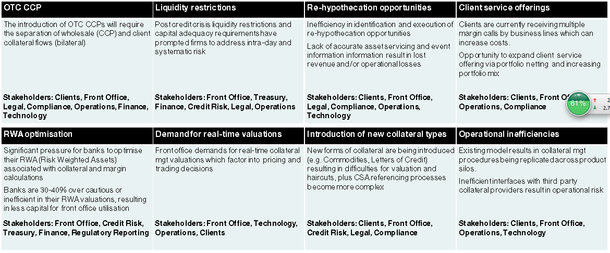
Origins of Financial Crisis
Overview of Dodd Frank Act
The Impact on Collateral Management
Summary
Brief Summary
Strategic and operational drivers category

Slide 21


Slide 22
CM improvement
Origins of Financial Crisis
Overview of Dodd Frank Act
The Impact on Collateral Management
Summary
Brief Summary
Benchmarks
Product coverage
Trade valuation methodology
Exposure calculation methodology
Exposure netting/aggregation
Exposure/liquidity management
Collateral optimization
Client service
Workflow
STP

Slide 23
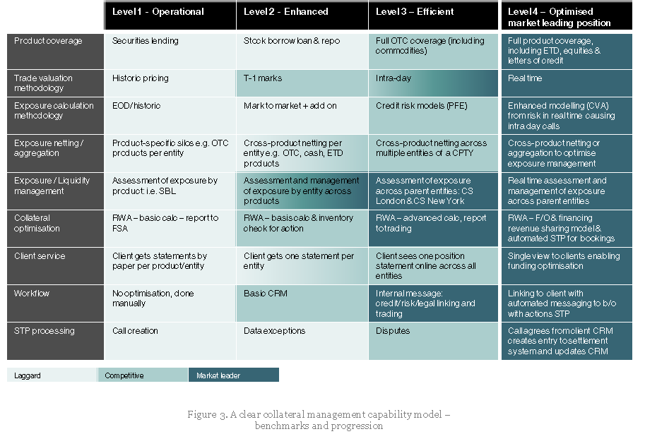

Slide 24


Slide 25
Benefits of optimization
Origins of Financial Crisis
Overview of Dodd Frank Act
The Impact on Collateral Management
Summary
Brief Summary
Greater efficiency
“True risk” alignment
Clarity of vision
Real time platform
Full STP functionality

Slide 26
What financial crisis does to collateral and margin
Origins of Financial Crisis
Overview of Dodd Frank Act
The Impact on Collateral Management
Summary
Brief Summary
More collateral
More frequent margin calls

Slide 27
New collateral demand could reach $800 billion
Origins of Financial Crisis
Overview of Dodd Frank Act
The Impact on Collateral Management
Summary
Brief Summary
Central clearing for the majority of over-the-counter (OTC) derivatives trades
Robust operational control and capital requirement of non-cleared OTC derivatives trades

Slide 28
Margin calls can jump up to 1000%
Origins of Financial Crisis
Overview of Dodd Frank Act
The Impact on Collateral Management
Summary
Brief Summary
Margin for both counterparties and no thresholds for variation margin
Clearing fragmentation between different clearinghouses
Multiple region clearing or more kinds of currency on margin call

Slide 29
The impact on firms
Origins of Financial Crisis
Overview of Dodd Frank Act
The Impact on Collateral Management
Summary
Brief Summary
Larger cash balance needed to meet more frequent margin call
Necessity to update current operation process to increase collateral capabilities
More bookkeeping cost

Slide 30
Solutions and opportunities
Origins of Financial Crisis
Overview of Dodd Frank Act
The Impact on Collateral Management
Summary
Brief Summary
Link and integrate various collateral processes
Portfolio margining that use offsetting risk to reduce margin
Collateral optimization to identify, pool and allocate collateral efficiently

Slide 31
Summary

Slide 32
Question?

